Slide 1
Java Mini Project
Restaurant Bill Generation
Group Members
Shakti Kumar Singh Aditya Kumar Abhinav Oli

Slide 2
INDEX
Introduction
Features
Flow Diagram
Technology Used
Program Structure
Working
Future Scope and Improvements
Conclusion

Slide 3
INTRODUCTION
A simple GUI based billing system that help the user to generate the total bill according to the items chosen by customers.
Can be used at various places like general items shops, restaurants and marts.
Maintains a dynamic table to choose and remove items according to the wish of user.

Slide 4
Features
Adding items with price and quantity.
Removing items from the list
Generating the bill
Saving the bill
Loading the previous bill
Printing the Bill (Hard Copy)

Slide 5
Flow Diagram
User Input for Items
Add Item to Table
Generate
Bill
Save Bill
User Clears the entry
User Removes
An Item
END
Load Bill
Print Bill

Slide 6
Technology Used
Java Language
Swing
Components
awt
JFrame
JButton
JTextfield
JTable
JPanel
Action Listener

Slide 7
Structure Of Program
Item Class
Bill Class
BillGenerationSystem
Constructor to initialize the frame
Action listener to listen to the clicks.
main

Slide 8
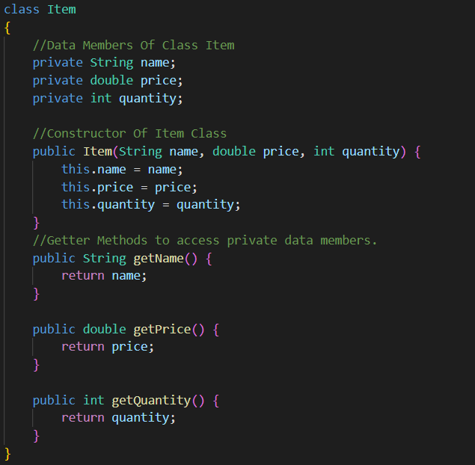
Item Class

Slide 9
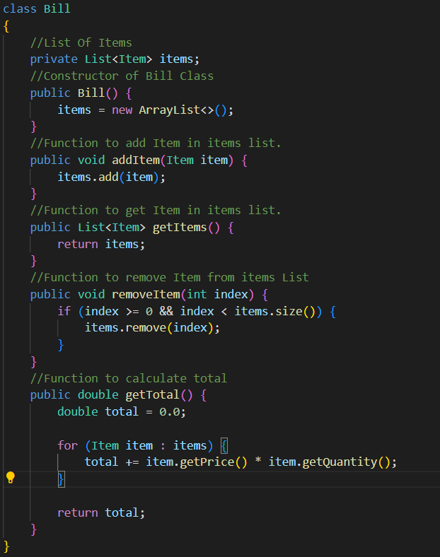
Bill Class

Slide 10
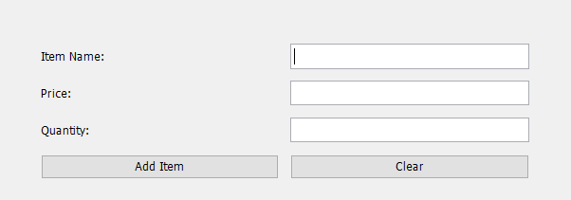
BillGenerationSystem Class
Panel 1

Slide 11
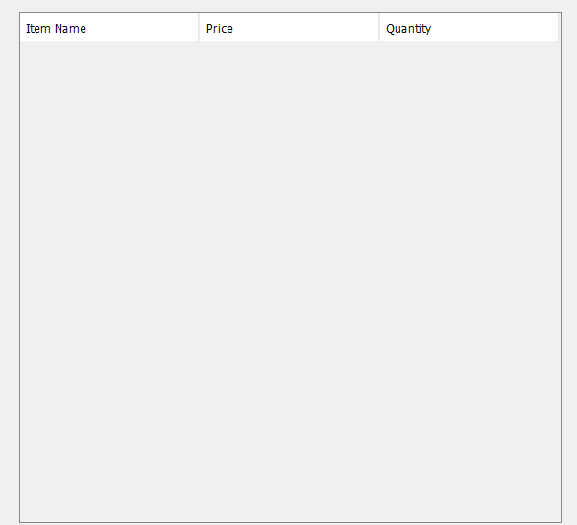
Panel 2

Slide 12

Panel 3

Slide 13
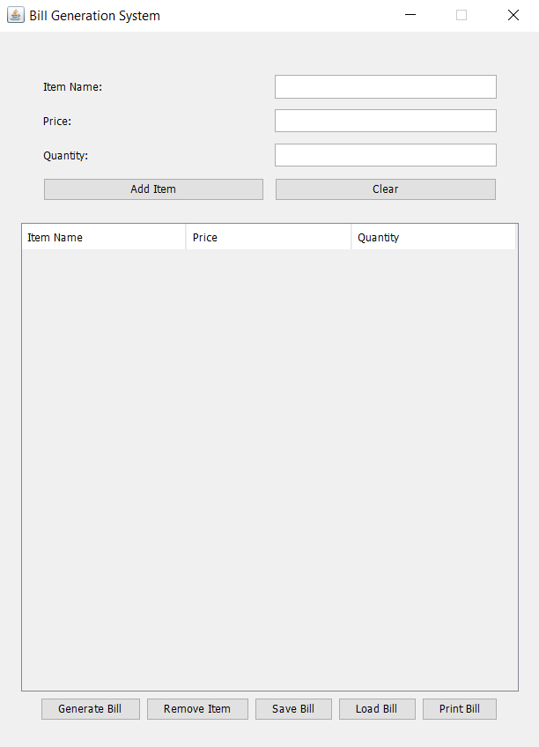
Adding Panels to Frame Container

Slide 14
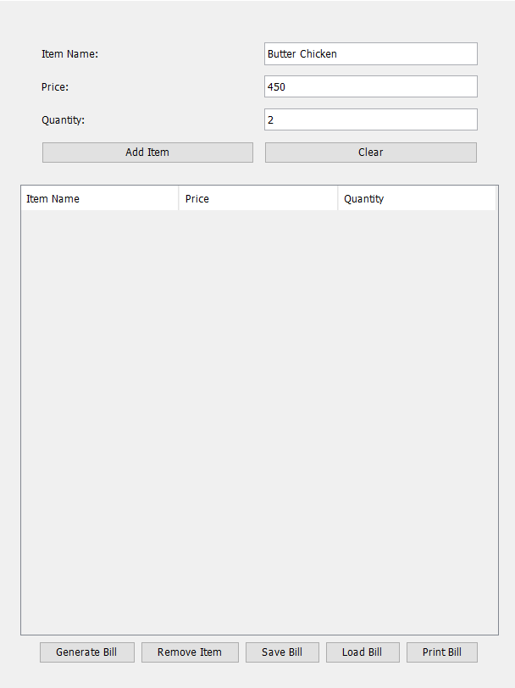
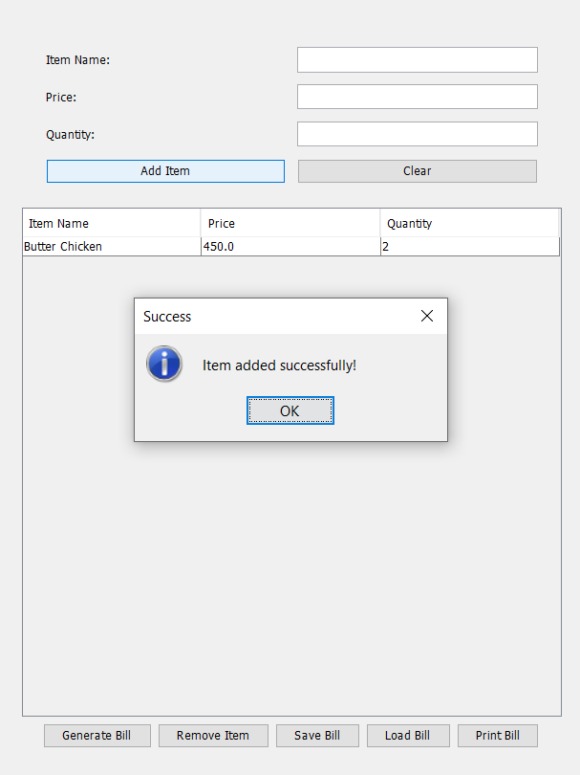
Adding a Item

Slide 15
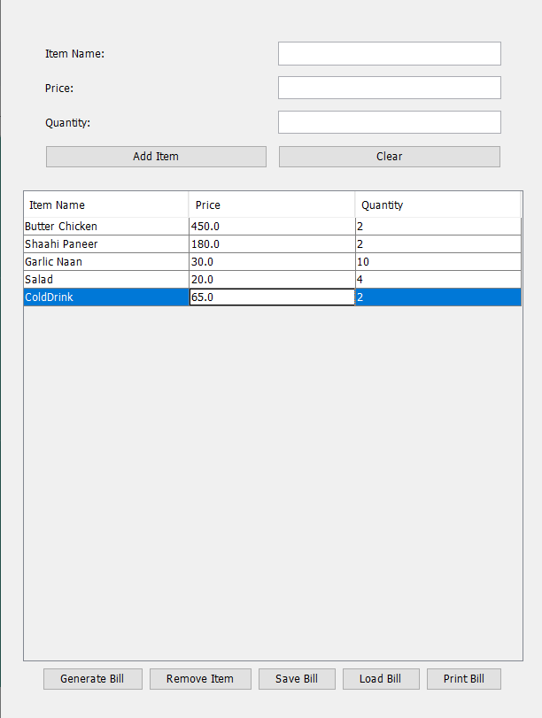
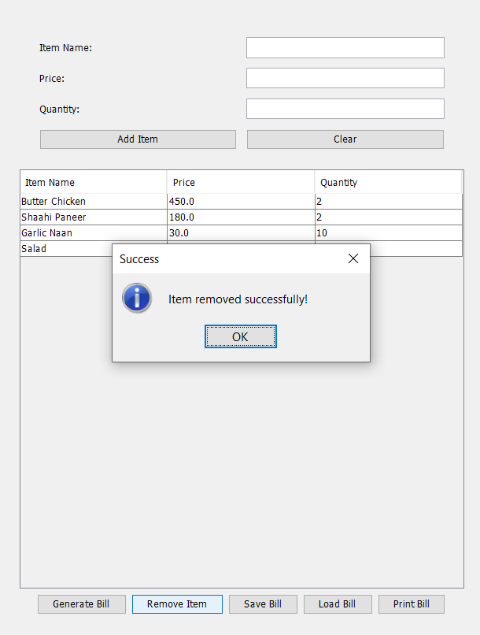
Removing An Item

Slide 16
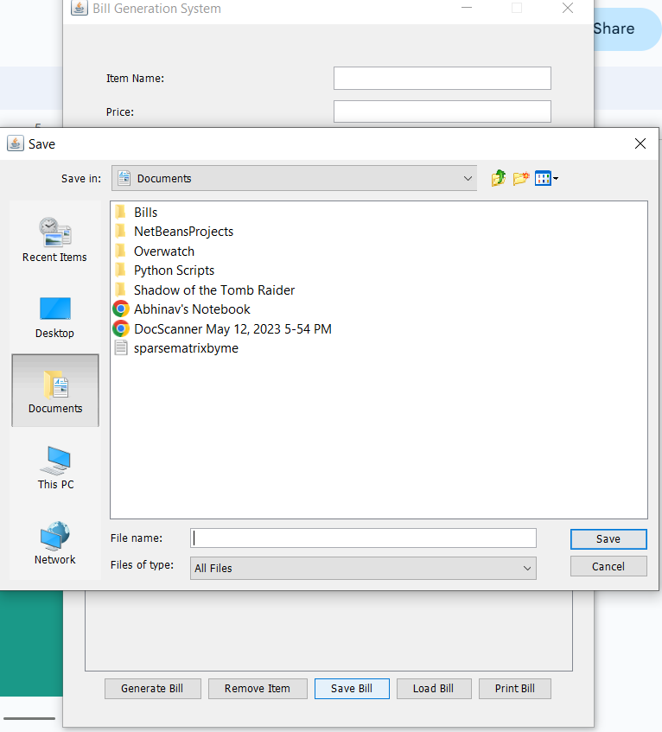
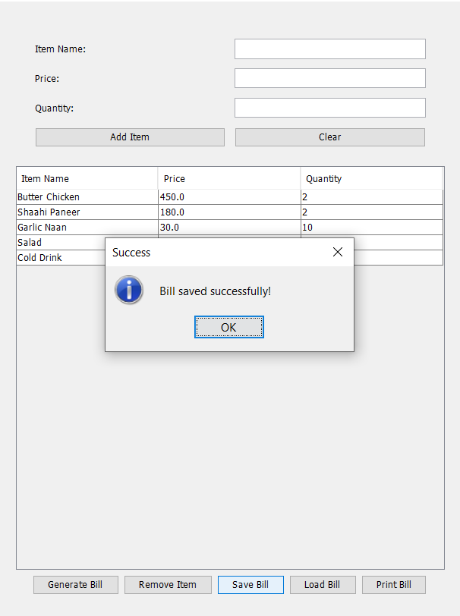
Saving The Bill

Slide 17
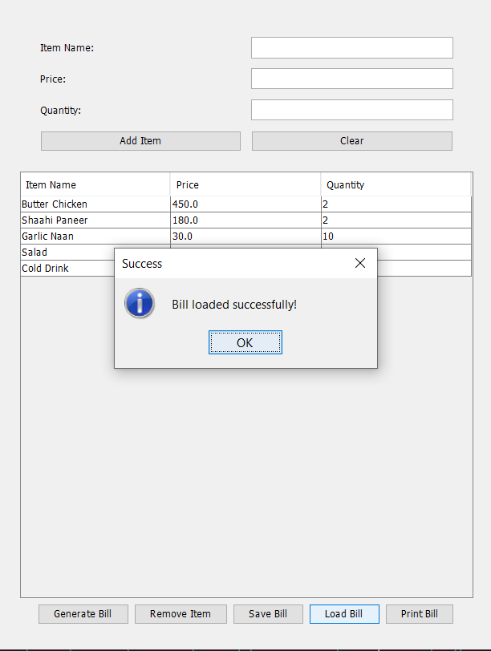
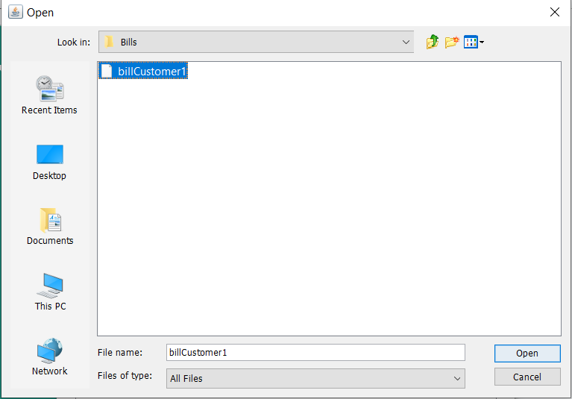
Loading the Bill

Slide 18
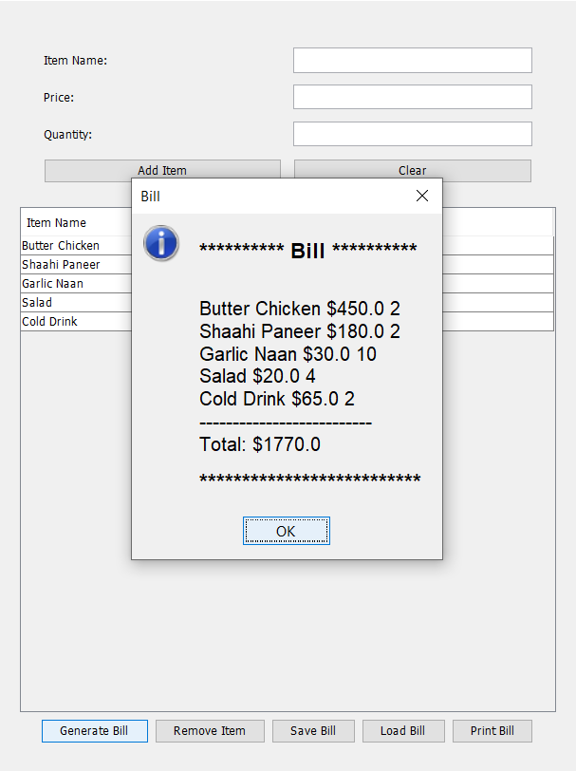
Generating the Bill

Slide 19
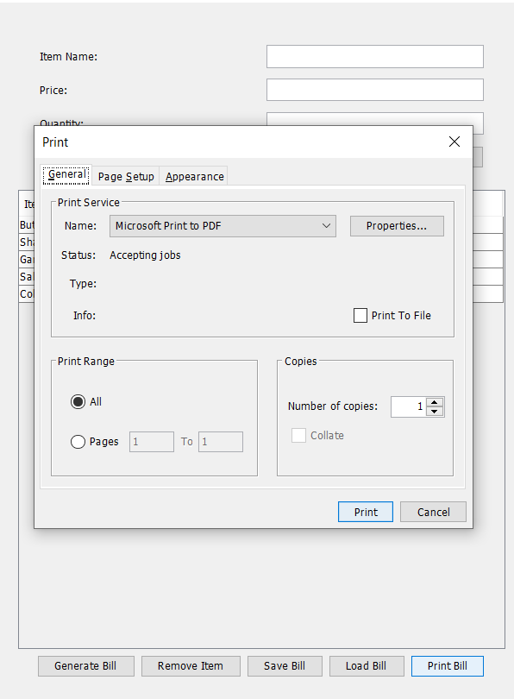
Printing the Bill

Slide 20
Improvements And Future Scope
GUI can be improved with more features like item count buttons.
Creating Login Panel
Storing the transactions using a database.
Validations
Searching and Filtering
Adding undo and redo functionality

Slide 21
Conclusion
In summary, the Bill Generation System project offers an effective solution for businesses to streamline their billing processes. By automating tasks, improving accuracy, and enhancing efficiency, the system can save time, reduce errors, and ultimately contribute to the success and growth of businesses.

